Slide 1
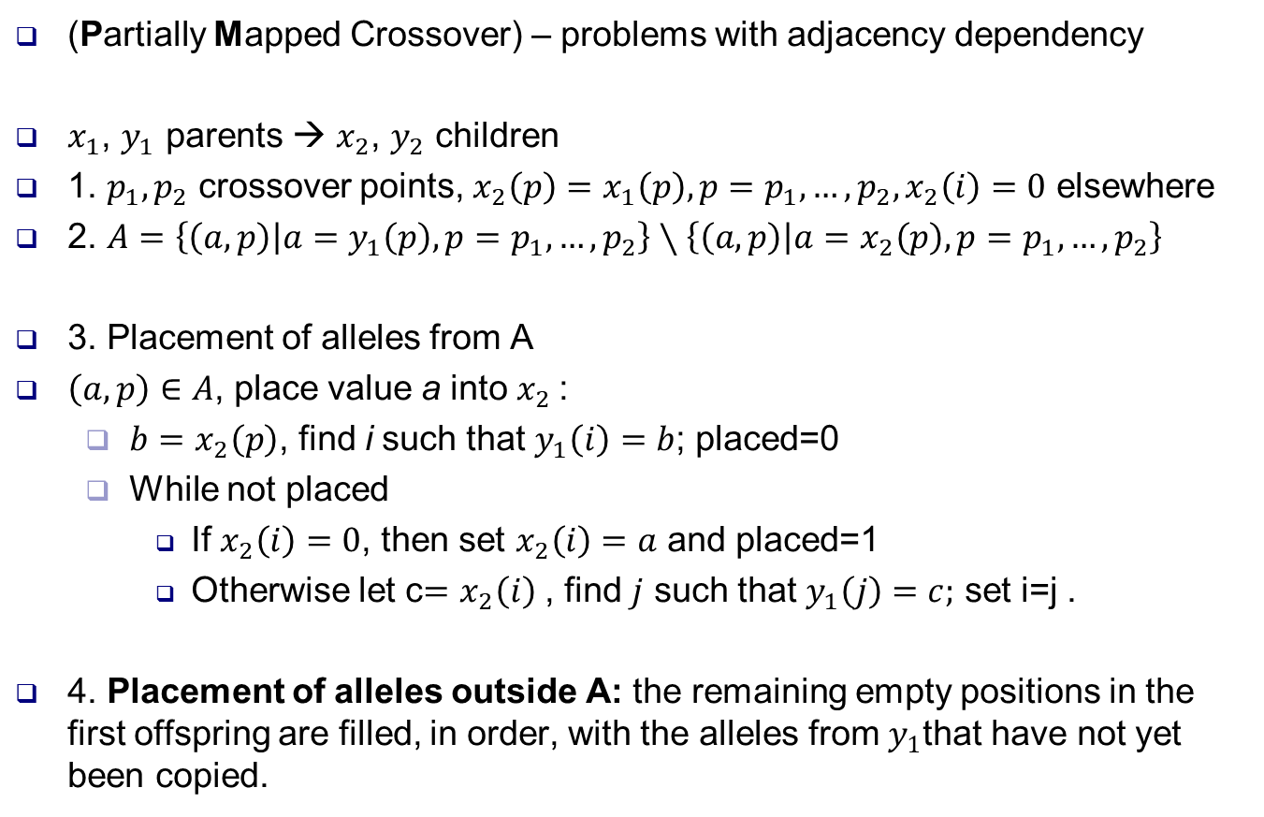
PMX Operator
(Partially Mapped Crossover) – problems with adjacency dependency
$x_{1}$, $y_{1}$ parents → $x_{2}$, $y_{2}$ children
1. $p_{1},p_{2}$ crossover points, $x_{2}\left(p\right)=x_{1}\left(p\right), p=p_{1},…,p_{2},x_{2}\left(i\right)=0$ elsewhere
2. $A=\left\{\left(a,p\right) | a=y_{1}\left(p\right), p=p_{1},…,p_{2}\right\}∖\left\{\left(a,p\right) | a=x_{2}\left(p\right), p=p_{1},…,p_{2}\right\}$
3. Placement of alleles from A
$\left(a,p\right)∈A$, place value a into $x_{2}$:
$b=x_{2}\left(p\right)$, find i such that $y_{1}\left(i\right)=b$; placed=0
While not placed
If $x_{2}\left(i\right)=0$, then set $x_{2}\left(i\right)=a$ and placed=1
Otherwise let c$=x_{2}\left(i\right)$ , find $j$ such that $y_{1}\left(j\right)=c;$ set i=j .
4. Placement of alleles outside A: the remaining empty positions in the first offspring are filled, in order, with the alleles from $y_{1}$that have not yet been copied.

Slide 2
Example 1
m=10, p1=4, p2=7
2
5
7
2
5
7
6
9
3
a=7, p=4, b=4
i=10, x2(10)=0 → x2(10)=7
a=2, p=6, b=1
i=2, x2(2)=0 → x2(2)=2
a=5, p=7, b=8
i=5, x2(5)=10 ≠ 0 → i=9
i=9, x2(9)=0 → x2(9)=5

Slide 3
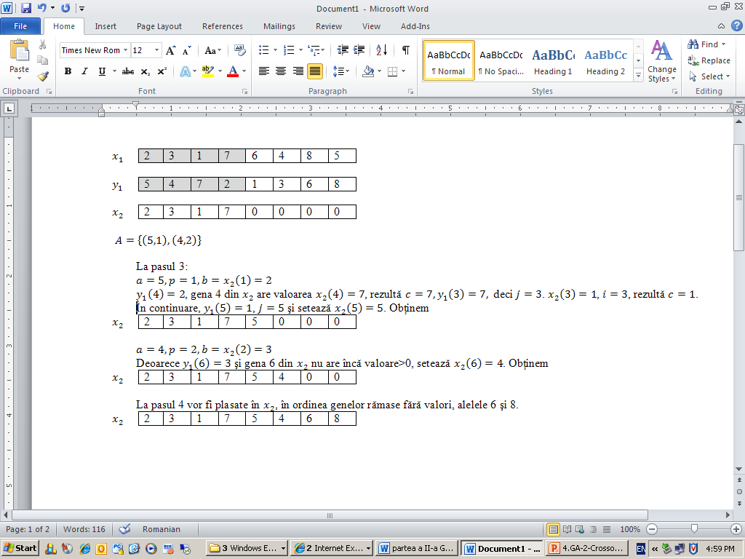
Exemplul 2
m=8, p1=1, p2=4

Slide 4
